Slide 1

Human resources slide 1
DATA VISUALIZATION OF HR DATASET
OGTIP DATA SCIENCE 2023
PROJECT 2
KANAN JABBAROV

Slide 2
Human resources slide 2
AGENDA
INTRODUCTION
DESCRIPTIVE STATISTICS OF RELEVANT FIELDS
SALARY - ORIENTED ANALYSIS
DEMOGRAPHIC - ORIENTED ANALYSIS
DEPARTMENT- ORIENTED ANALYSIS
SUMMARY

Slide 3

Human resources slide 3
INTRODUCTION
I was given the limited HR data from a reputed organization XYZ technologies. The Data include relevant information of the employees like id, designation ,performance score ,salary etc.
The objective of this project is to create visualizations that enhance the understanding of the HR dataset, extracting valuable insights from the data. The project utilizes data visualization tools such as Matplotlib, Seaborn, Plotly, and Folium.

Slide 4
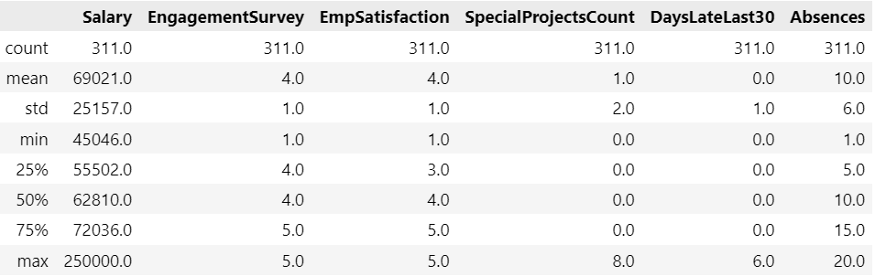
Human resources slide 4
DESCRIPTIVE STATISTICS OF RELEVANT FIELDS

Slide 5
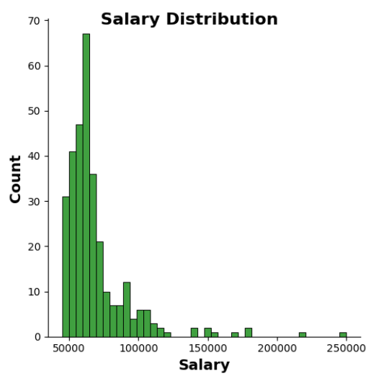
Human resources slide 5
SALARY ANALYSES
This chart shows that salary distribution is right-skewed, meaning that there are a few employees with very high salaries and many employees with lower salaries.

Slide 6
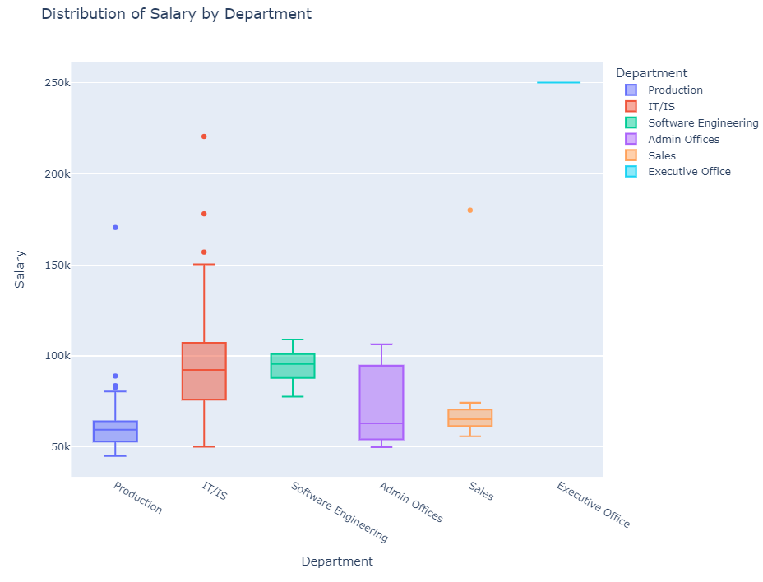
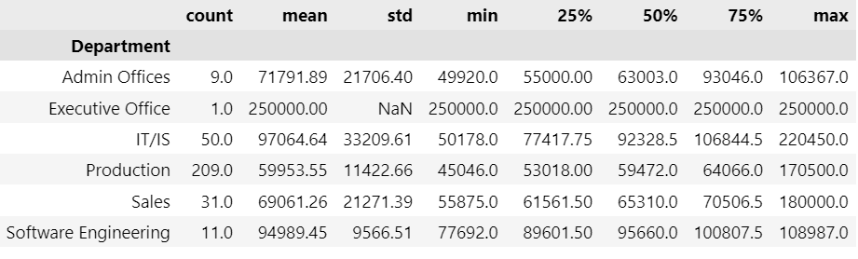
Human resources slide 8
SALARY ANALYSES
The box plot illustrates that the Production department exhibits the lowest median salary, while the Executive Office commands the highest median salary within the dataset.

Slide 7
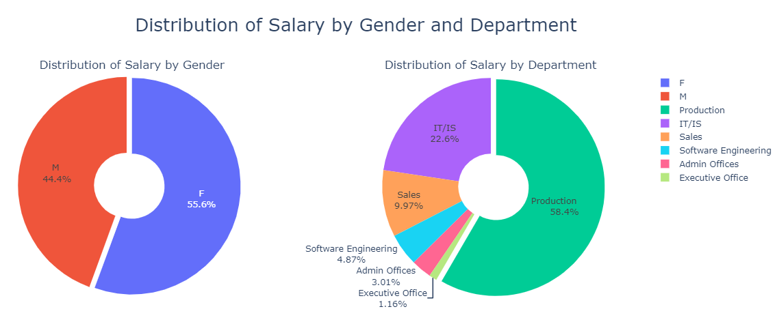
Human resources slide 6
SALARY ANALYSES
From the given pie charts we can see that the distribution of salary for Women is 11% greater than Men. Also up to 90% of wages are distributed among three Departments such as Production(58.4%), IT/IS(22.6%) and Sales(9.97%) respectively.

Slide 8
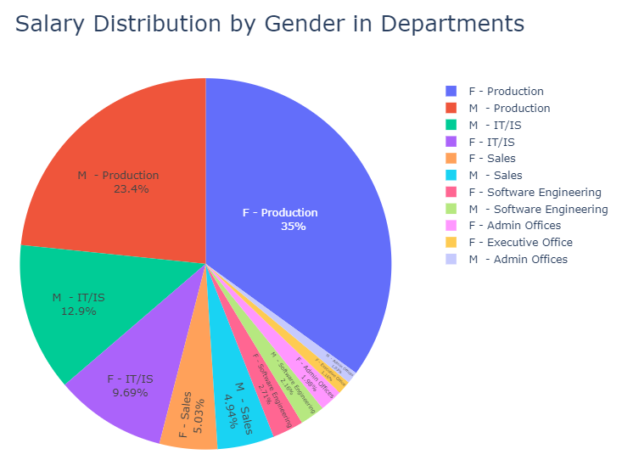
Human resources slide 7
SALARY ANALYSES
From the pie chart we can observe in the Production department, female employees receive a higher percentage of the total salary distribution compared to their male counterparts, with females accounting for 35% and males for 23.4%.
In the IT/IS department, male employees receive a higher percentage of the total salary distribution compared to their female counterparts, with males accounting for 12.9% and females for 9.69%.
In the Sales department, female employees receive a slightly higher percentage of the total salary distribution compared to males, with females accounting for 5.03% and males for 4.94%.

Slide 9
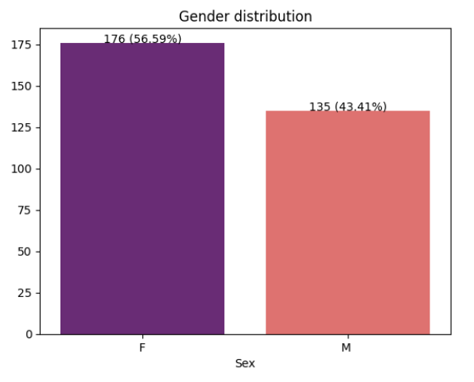
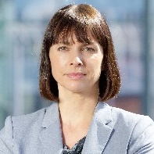

Human resources slide 9
DEMOGRAPHIC ANALYSIS
The bar chart indicates that there are 176 (56.59%) female employees and 135 (43.41%) male employees.

Slide 10
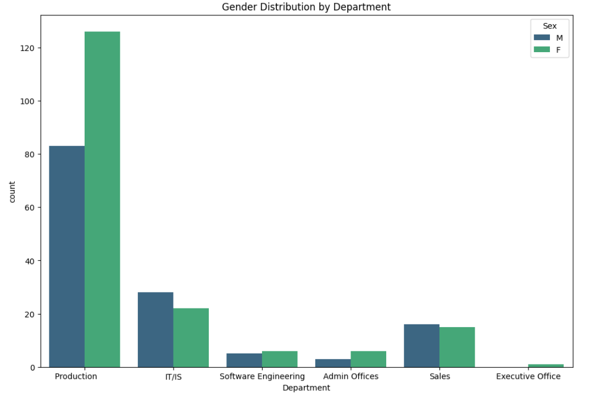
DEMOGRAPHIC ANALYSIS
In the Production department, females outnumber their male colleagues. Additionally, there are slightly more females in the Software Engineering and Admin Office departments.

Slide 11
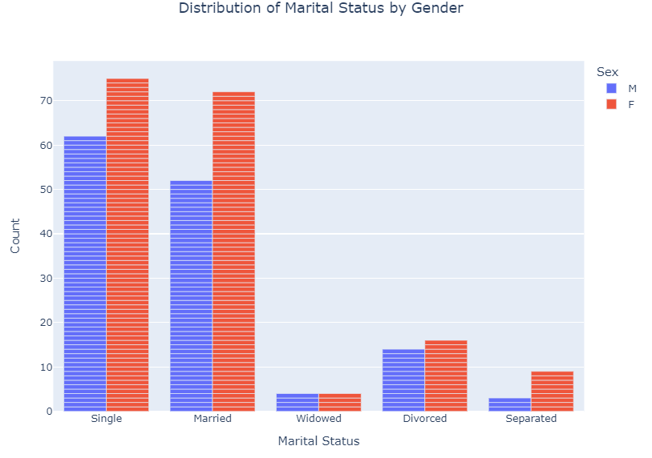
DEMOGRAPHIC ANALYSIS
The bar chart reveals that the predominant marital statuses are Single and Married, with females outnumbering their male counterparts in both categories.

Slide 12
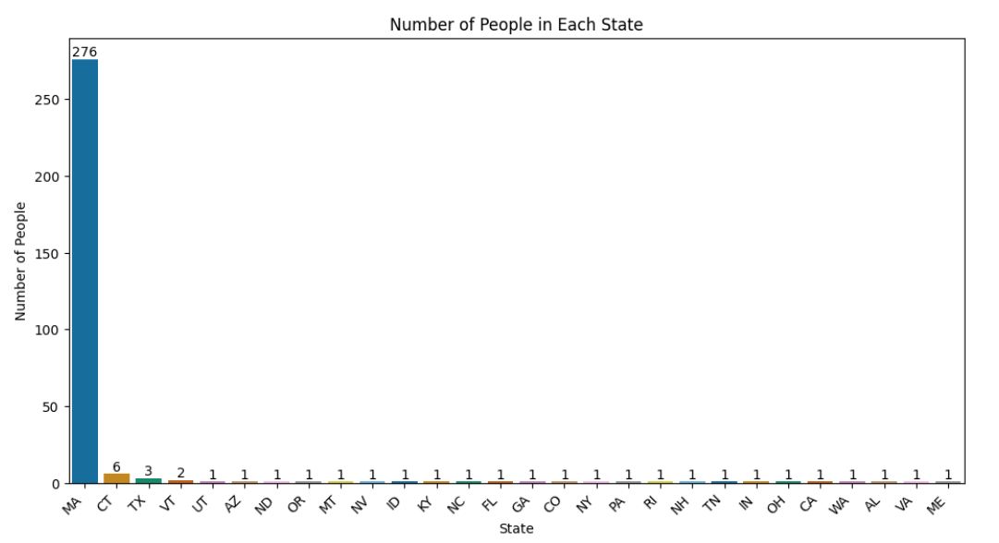
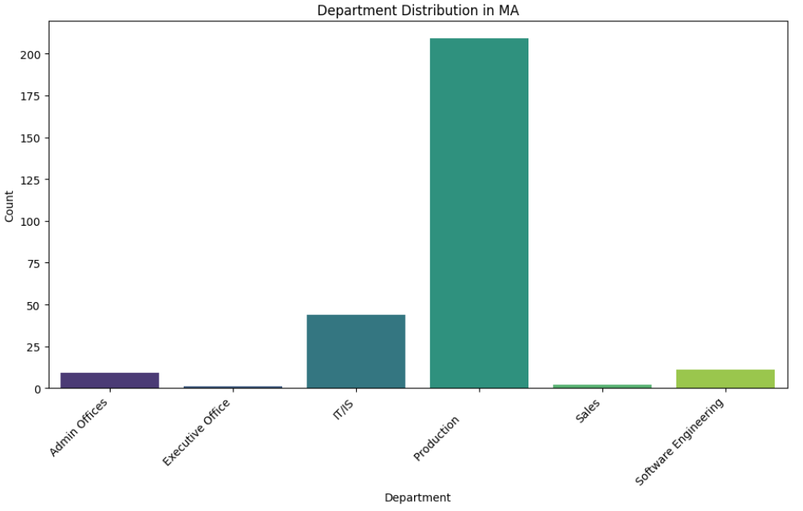
DEMOGRAPHIC ANALYSIS
The primary state of employment is Massachusetts(MA),with 276 individuals working there. Moreover, it is evident that the Production and IT/IS departments are predominantly located in the state of Massachusetts.

Slide 13
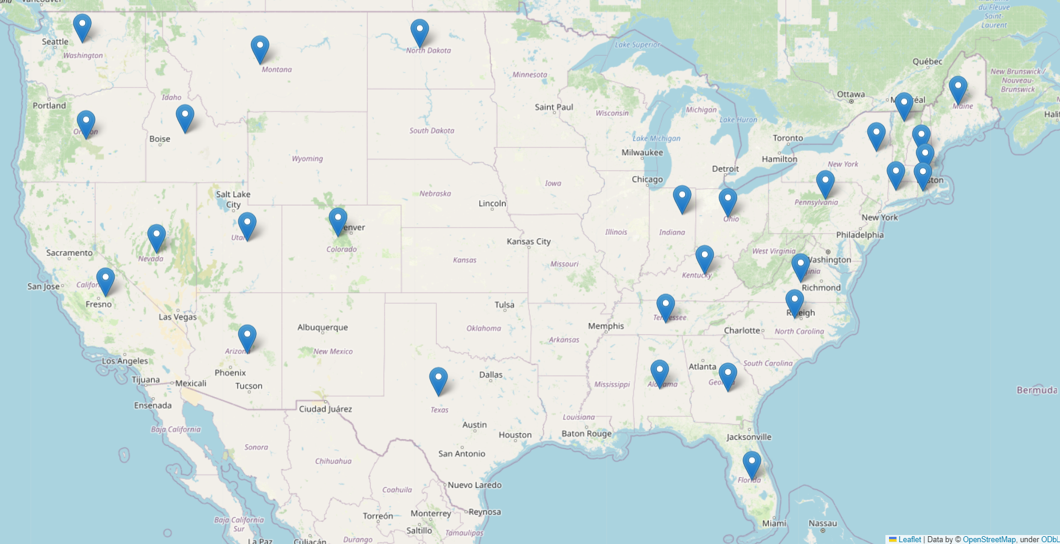
The majority of the company's employees reside in the Eastern and Western states.

Slide 14
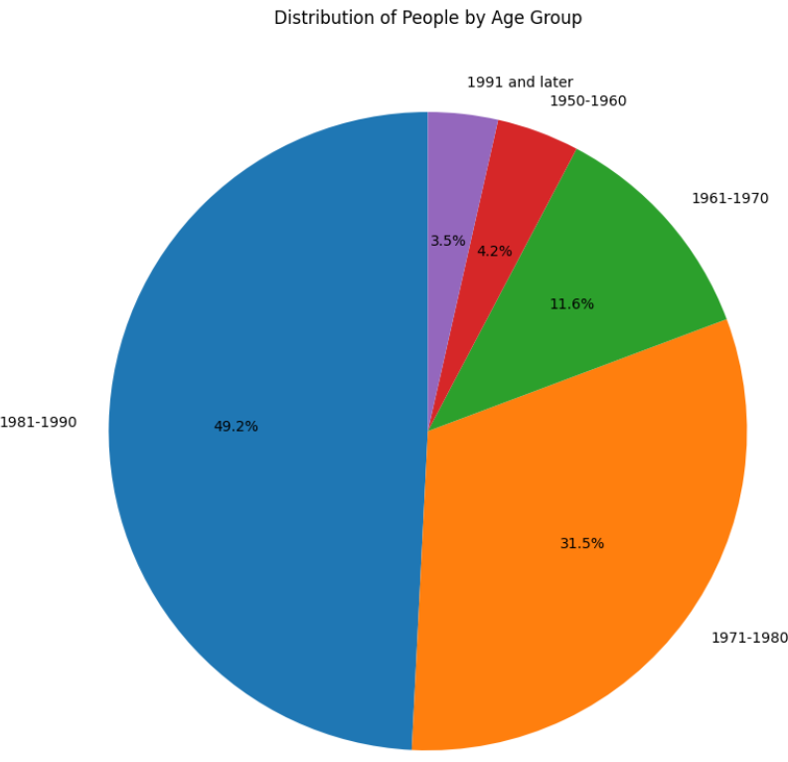
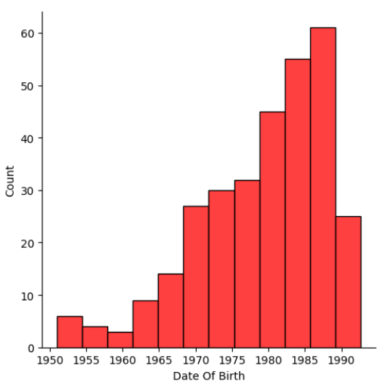
Distribution of ages
DEMOGRAPHIC ANALYSIS
The visualizations make it evident that 80.7% of employees fall within the age range of 33 to 52.

Slide 15
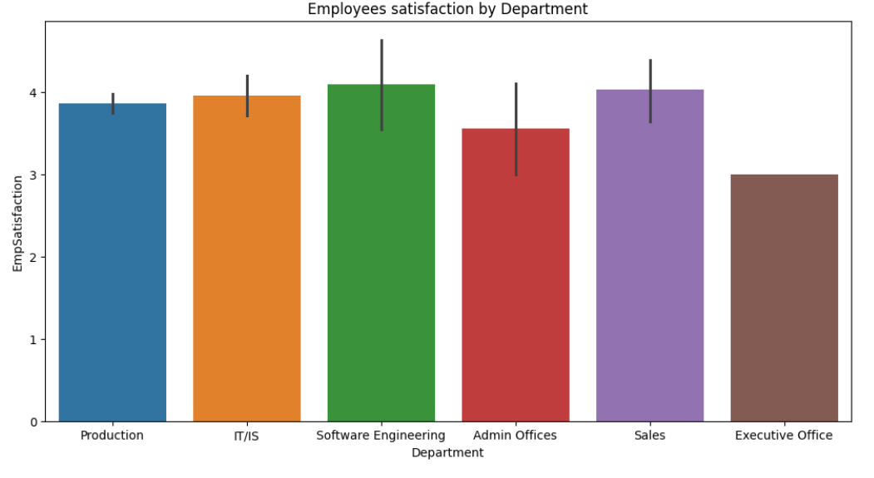
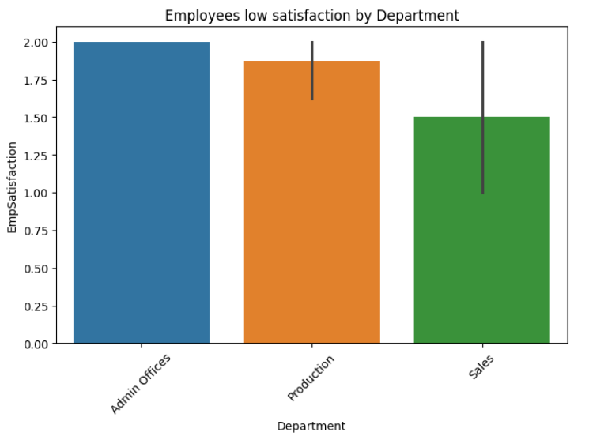
DEPARTMENT ANALYSIS
The overall satisfaction rates across all departments are generally high. However, three departments—Admin Office, Production, and Sales demonstrate lower satisfaction rates.

Slide 16
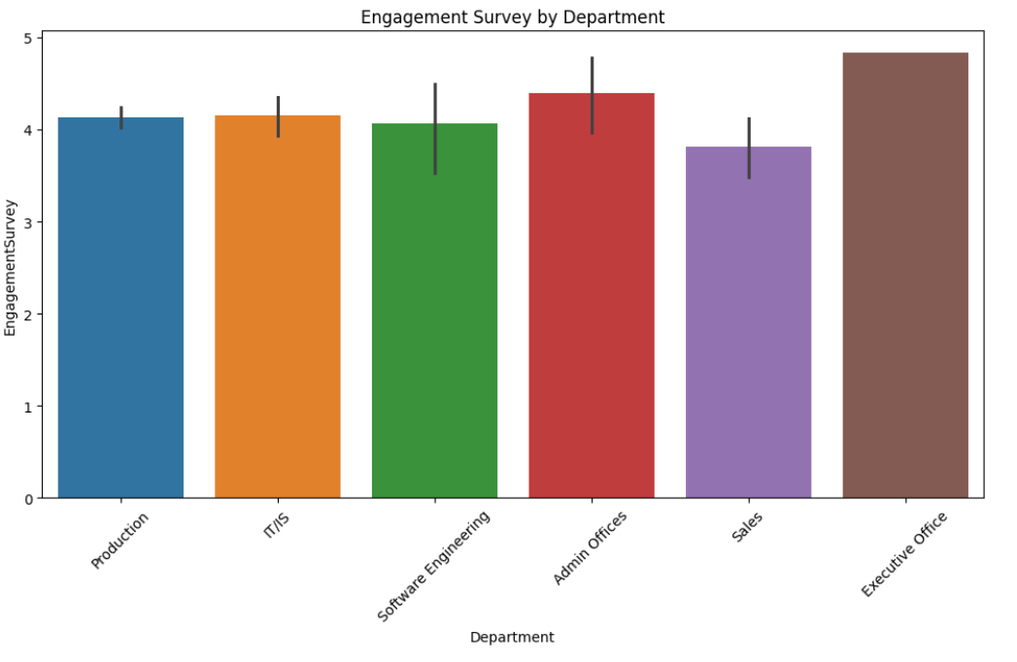
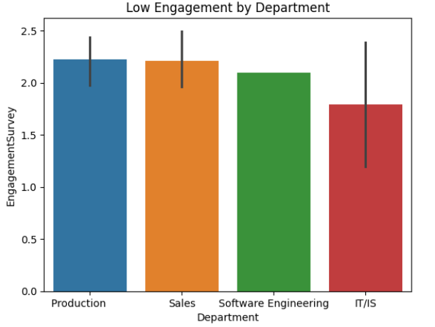
DEPARTMENT ANALYSIS
The overall Engagement survey rates across all departments are generally high. However, three departments—Admin Office, Production, and Sales—demonstrate lower satisfaction rates.

Slide 17
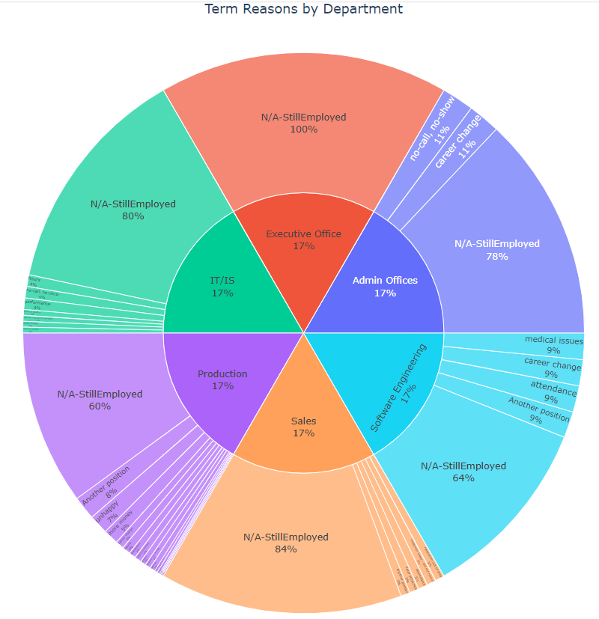
DEPARTMENT ANALYSIS
The main Termination reason for Production, Sales and Software Engineering departments are another position. Other Termination reasons are unhappy, performance and hours.

Slide 18
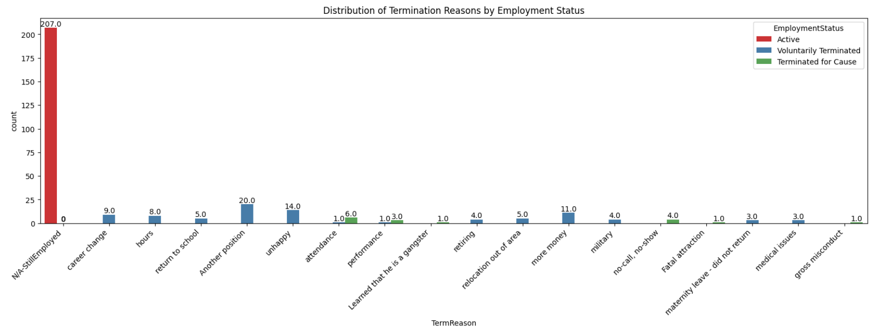
DEPARTMENT ANALYSIS
The majority of the workforce is currently active. Additionally, voluntary terminations often occur due to reasons such as pursuing another position, experiencing dissatisfaction, or seeking higher compensation. In cases of termination for cause, reasons include issues related to attendance, performance, and instances of no-call, no-show.

Slide 19
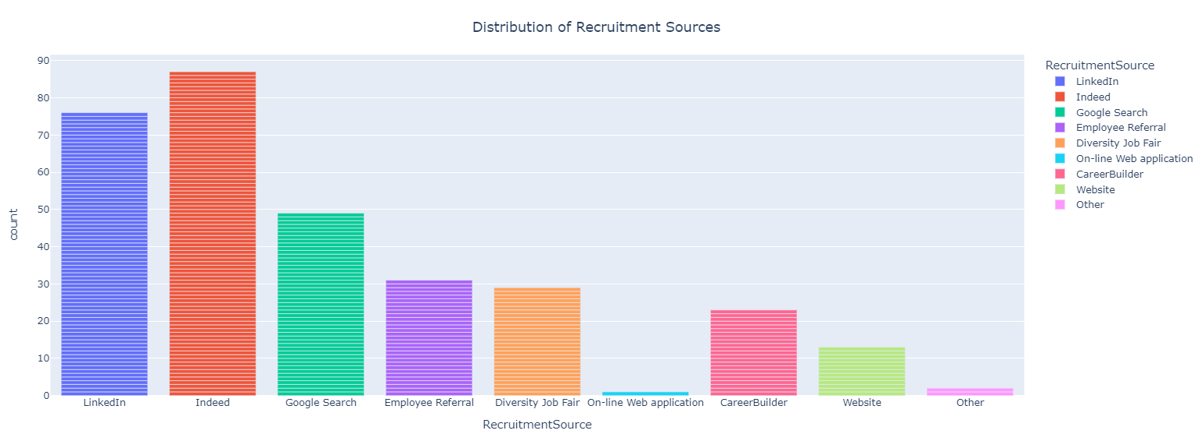
DEPARTMENT ANALYSIS
The company employs individuals primarily through three major recruitment sources: Indeed, LinkedIn, and Google Search.

Slide 20
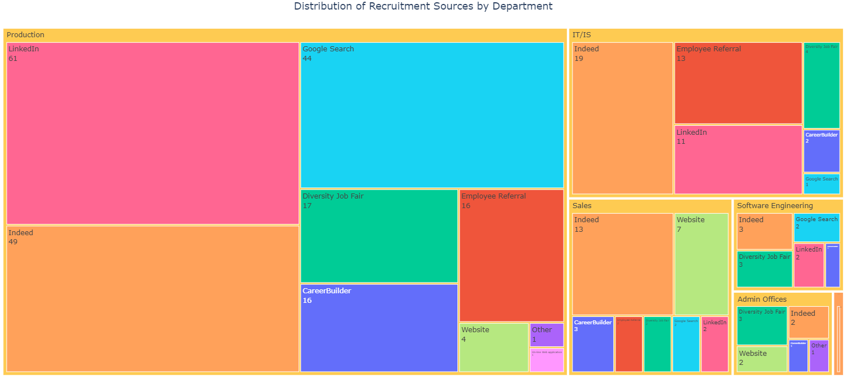
DEPARTMENT ANALYSIS
Indeed serves as the primary recruitment source for departments such as IT/IS, Sales, Software Engineering, and the Executive Office. Conversely, LinkedIn is the main source for the Production department, while Diversity Job Fair is the primary source for the Admin Office.

Slide 21
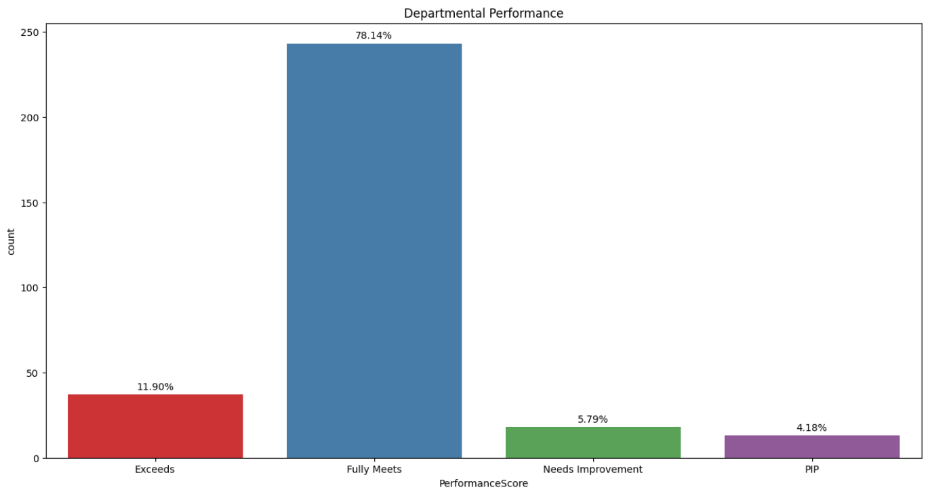
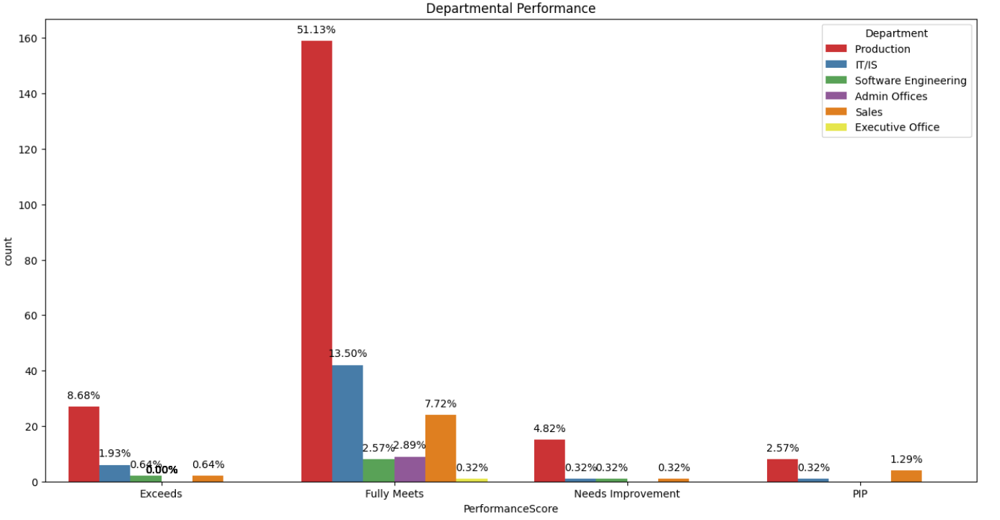
DEPARTMENT ANALYSIS
In general, there is a favorable trend in performance scores, with 78% meeting expectations and nearly 12% exceeding them. Moreover, departments like Production and Sales exhibit the highest utilization of Performance Improvement Plans (PIPs).

Slide 22
SUMMARY
Most employees earn lower wages, while a few receive higher pay. Surprisingly, the Production department, despite having the lowest average pay, leads in terms of salary distribution.
The company has a higher proportion of female employees, with both genders prominently engaged in the Production department.
The prevalent marital statuses are single and married, reflecting a diverse employee demographic. A significant 89% of the workforce resides and works in Massachusetts, with the Production department being fully represented in the state.
The majority of employees fall within the age range of 33 to 52, indicating a workforce concentrated in the mid-career to later career stages.
Certain departments, such as Production and Sales, demonstrate lower satisfaction and engagement scores. This suggests areas for potential improvement and focus.
Overall, a positive trend is observed in employee performance scores, with 66% of workers performing well. Key recruitment sources for the company include Indeed and LinkedIn.

Slide 23
Human resources slide 10
Thank You

